Slide 1
Database Systems
Lecture 1
Introduction

Slide 2
Today’s agenda
Database introduction and definition
DBMS functionalities
Characteristics of database approach

Slide 3
Basic Definitions
Database: A collection of related data.
Data: Known facts that can be recorded and have an implicit meaning.
Database Management System (DBMS): A software package/ system to facilitate the creation and maintenance of a computerized database.
Database System: The DBMS software together with the data itself. Sometimes, the applications are also included.

Slide 4
Database definition
A shared collection of logically related data, designed to meet the information needs of multiple users in an organization.

Slide 5
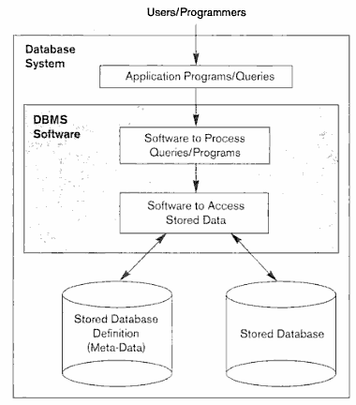
A simplified database system environment

Slide 6
Typical DBMS Functionality
Define a database : in terms of data types, structures and constraints
Construct or Load the Database on a secondary storage medium
Manipulating the database : querying, generating reports, insertions, deletions and modifications to its content
Concurrent Processing and Sharing by a set of users and programs – yet, keeping all data valid and consistent

Slide 7
Typical DBMS Functionality
Other features:
Protection or Security measures to prevent unauthorized access
“Active” processing to take internal actions on data
Presentation and Visualization of data

Slide 8
Example of a Database (with a Conceptual Data Model)
Mini-world for the example: Part of a UNIVERSITY environment.
Some mini-world entities:
STUDENTs
COURSEs
SECTIONs (of COURSEs)
(academic) DEPARTMENTs
INSTRUCTORs
Note: The above could be expressed in the ENTITY-RELATIONSHIP data model.

Slide 9
Example of a Database (with a Conceptual Data Model)
Some mini-world relationships:
SECTIONs are of specific COURSEs
STUDENTs take SECTIONs
COURSEs have prerequisite COURSEs
INSTRUCTORs teach SECTIONs
COURSEs are offered by DEPARTMENTs
STUDENTs major in DEPARTMENTs
Note: The above could be expressed in the ENTITY-RELATIONSHIP data model.

Slide 10
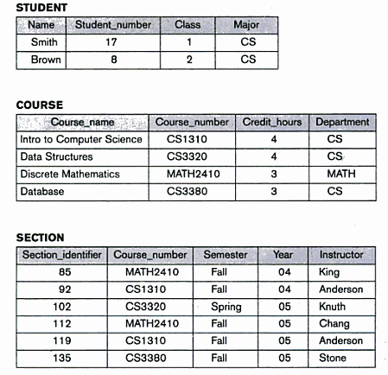
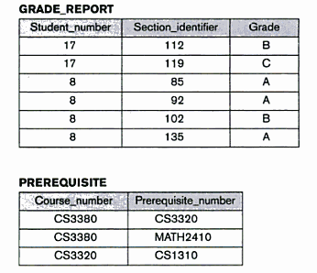
Example of a database

Slide 11
Main Characteristics of the Database Approach
Self-describing nature of a database system: A DBMS catalog stores the description of the database. The description is called meta-data). This allows the DBMS software to work with different databases.
Insulation between programs and data: program-data independence. Allows changing data storage structures without having to change the DBMS access programs.

Slide 12
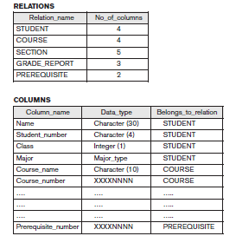
An Example of Database Catalog

Slide 13
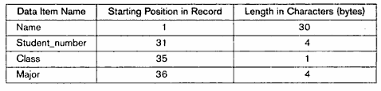
Storage format for a student record

Slide 14
Main Characteristics of the Database Approach
Insulation between programs and data: program-operation independence. Allows changing operations without having to change the DBMS access programs.
Data abstraction: The characteristic that allows program-data independence and program-operation independence is called data abstraction. DBMS provides users with conceptual representation of data that doesn’t include many of the details of how the data is stored or how the operations are implemented.

Slide 15
Main Characteristics of the Database Approach
Data Abstraction: A data model is a type of data abstraction that is used to provide this conceptual representation.
Support of multiple views of the data: Each user may see a different view of the database, which describes only the data of interest to that user.

Slide 16
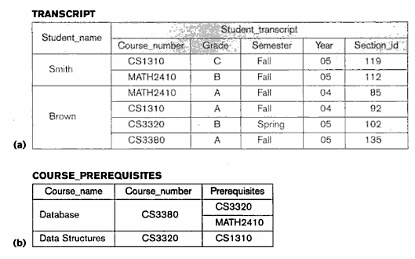
Student transcript and course prerequisites view

Slide 17
Main Characteristics of the Database Approach
Sharing of data and multiuser transaction processing : allowing a set of concurrent users to retrieve and to update the database. Concurrency control within the DBMS guarantees that each transaction is correctly executed or completely aborted. OLTP (Online Transaction Processing) is a major part of database applications.

Slide 18
Summary
Introduction
Basic definitions
Database
Data
DBMS
Database systems
An example database
Functionalities of database systems
Characteristics of database systems

